Slide 1
DEBOUNCING BUTTONS ON FPGA USING VERILOG CODE
A MINI PROJECT PRESENTATION
M.RAJESWARI
K.ROSHINI
H.SARANYA

Slide 2
Overview:
Introduction
Switch Bouncing
Debouncing
Debouncing circuit
How to implement Debouncing
Verilog code
Testbench
RTL schematic
Simulation Output
Conclusion

Slide 3
Introduction :
Using mechanical switches for a user interface is a ubiquitous practice. However, when these switches are actuated, the contacts often rebound, or bounce, off one another before settling into a stable state. Several methods exist to deal with this temporary ambiguity, using either hardware or software. Here, we look at correcting this problem with a simple digital logic circuit (a common task when interfacing FPGAs or CPLDs with pushbuttons or other switches). Generic Verilog code for the DeBounce module and the test fixture is included.

Slide 4

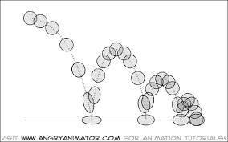
Switch Bouncing:
When we press a pushbutton or toggle switch or a micro switch, two metal parts come into contact to short the supply. But they don’t connect instantly but the metal parts connect and disconnect several times before the actual stable connection is made. The same thing happens while releasing the button. This results the false triggering or multiple triggering like the button is pressed multiple times. Its like falling a bouncing ball from a height and it keeps bouncing on the surface, until it comes at rest.
Simply, we can say that the switch bouncing is the non-ideal behavior of any switch which generates multiple transitions of a single input. Switch bouncing is not a major problem when we deal with the power circuits, but it cause problems while we are dealing with the logic or digital circuits. Hence, to remove the bouncing from the circuit Switch Debouncing Circuit is used

Slide 5
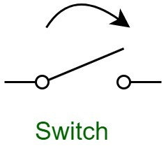
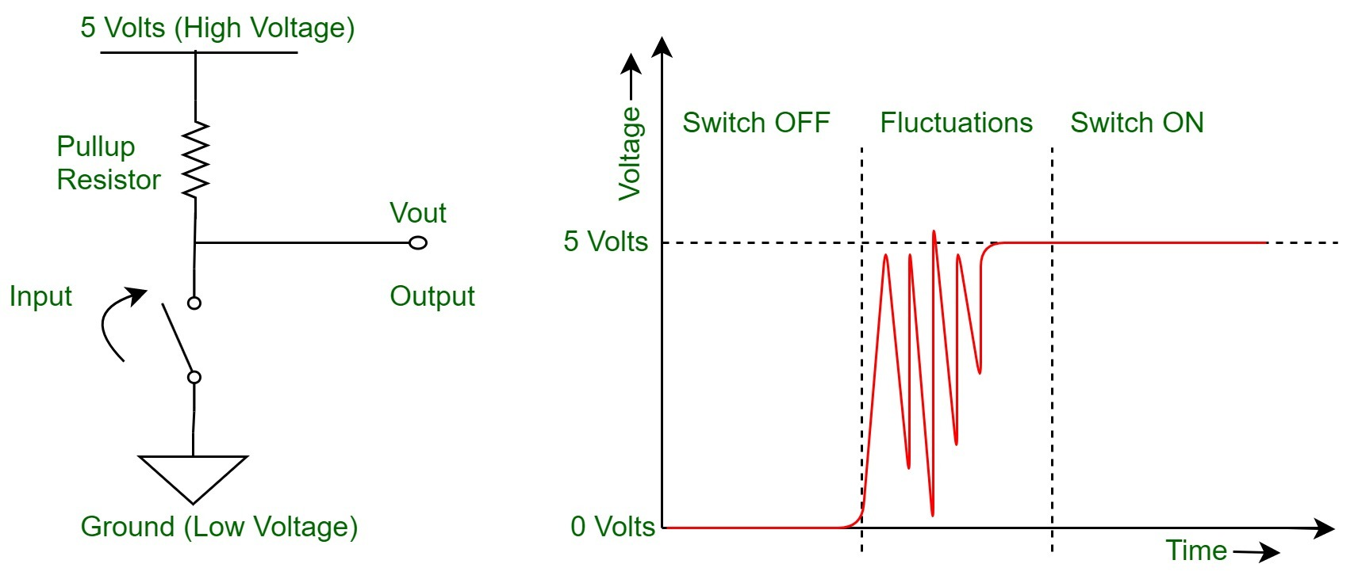
Debouncing :
We all know how a switch or a push button works, you simply press it to toggle its state. In electronics, switches are used to drive or represent many things, and these are mainly in the form of different voltage level, thus making the system binary, i.e either ON or OFF and in voltage levels High or Low. Thus, these voltage levels (e.g. 5 Volts = High = ON = closed circuit and 0 Volts = Low = OFF = open circuit) helps us to represent the binary logic of 0s (zeros) and 1s (ones).

Slide 6
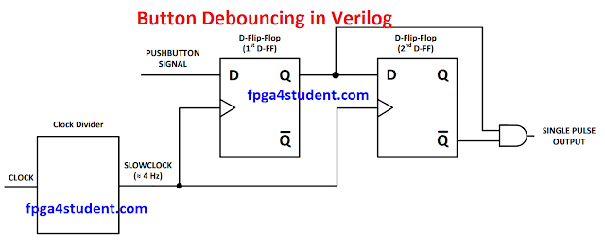
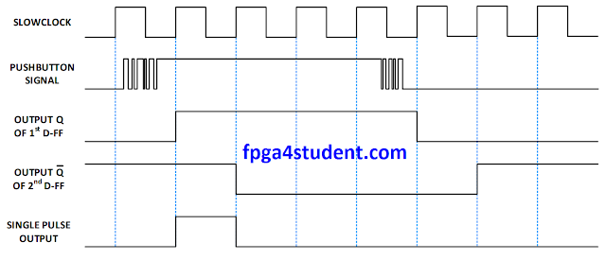
Debouncing Circuit :
If the switch is being used as a clock, several clock edges will be generated instead of just one. Consequently, it is necessary to debounce the switch. On way to do this is to simply wait until the transient phase (bouncing) is over and sample the switch. This can be done in Verilog with a counter and a clock source

Slide 7
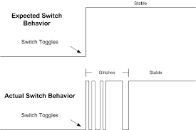
How to implement debouncing:
Fix button glitches on your development board
If you are using a development board that has switches, you should be careful. Physical switches such as push buttons and toggle switches are all subject to bouncing. Bouncing occurs when the switch is toggled or flipped. It happens in all switches as a result of the metal contacts coming together and apart quickly before they have time to settle out.

Slide 8
The image above shows the transition from logic low to logic high of a switch closing. One would expect a nice clean transition. However the spikes are where the switch contacts create glitches on the line. Imagine if this switch was used to start some task in your code. The task would be started and stopped many times very rapidly. This would create unwanted behavior. This switch is in need of some debounce filtering!
To do this in an FPGA, the simplest thing to do is to create a process (in VHDL) or an always block (in Verilog) that samples the switch input. Once the switch input has been stable for enough time, the input is stable and can be sent to the rest of your code. A good amount of time for this is several milliseconds at a minimum.
Your process or always block should be sampling the switch input all the time. Once it sees the switch input is different from its output, it should enable a counter. If the counter reaches the end, the output is reassigned to match the input. This happens because the switch was stable for long enough.

Slide 9
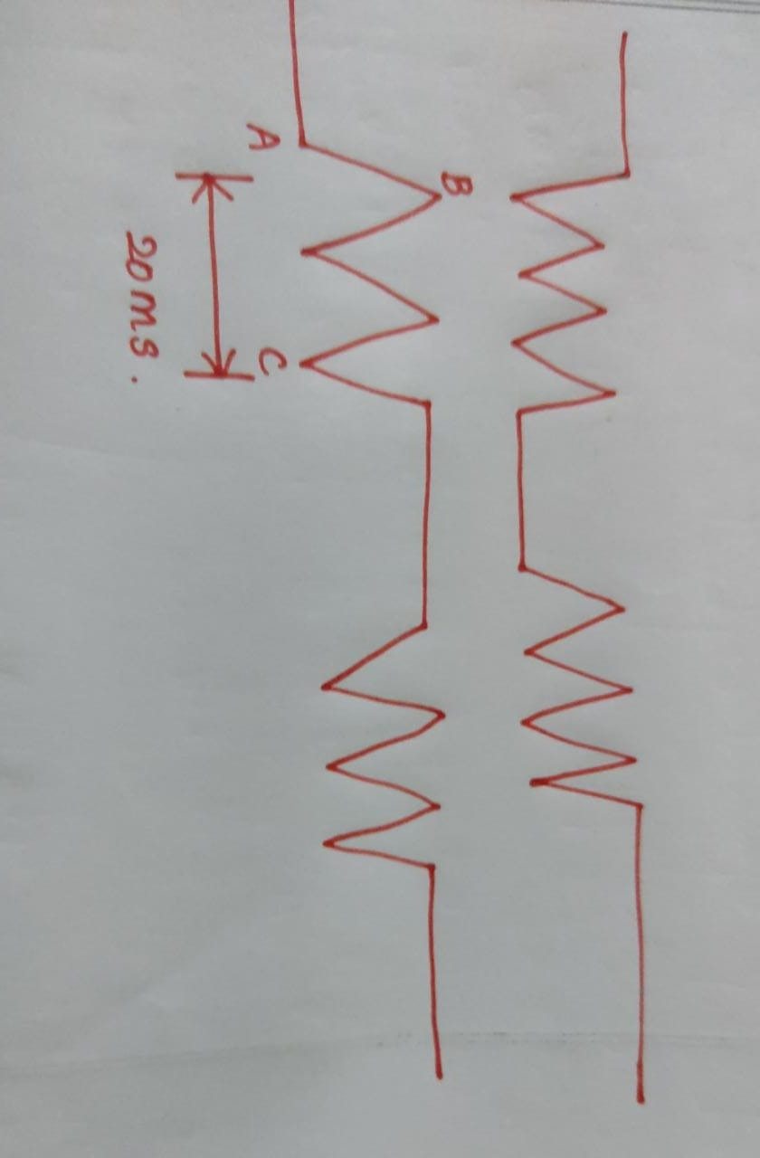
As the picture when we detect one jump ; A-B then we begin to count , if the time arrives 20ms ,we get the different value with A , we can say the key has been pressed , filter the bounce . This way character of the button is different . so now have solution 2

Slide 10
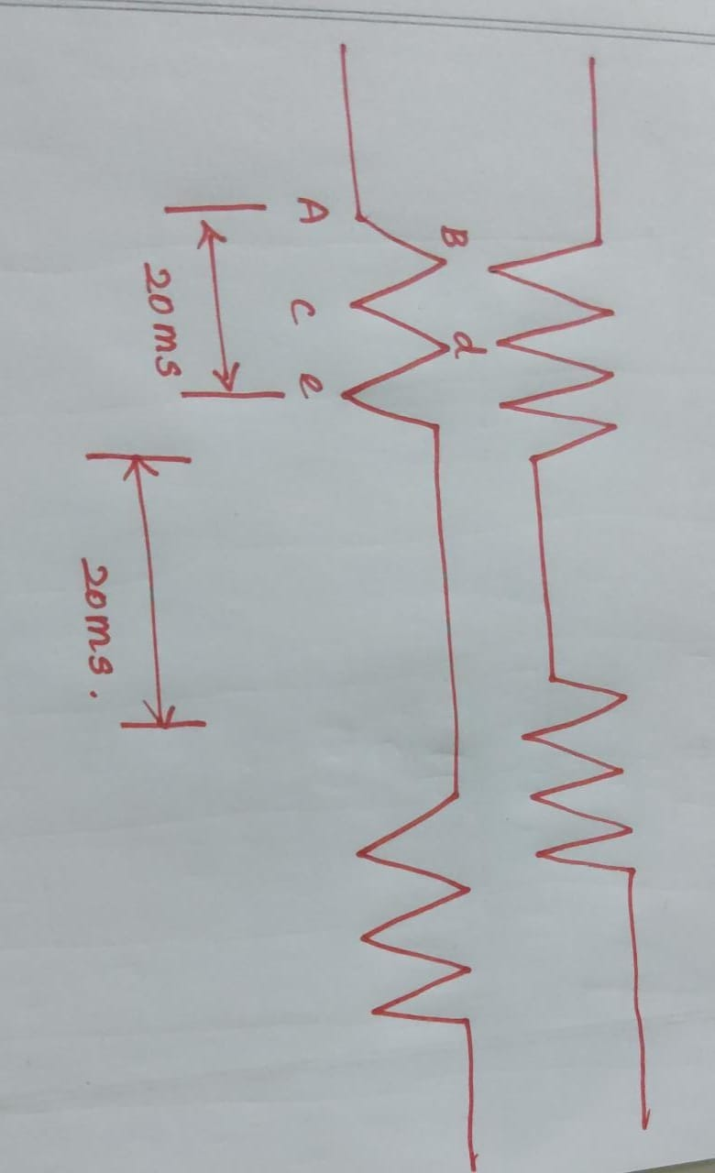
The second idea is that , from A-B , we detect one value change , but next clock B-C we get another value change so we clear the count , until to e point , after e point, the voltage level keep high , at the time,. We begin to count 20 ms , if during the 20 ms there are no more any level change so we can say we have filter the bounce and the key has been in stable , now we can generate one signal to tell our next module , the key has been pressed.

Slide 11
Verilog code:
Verilog code for button debouncing on FPGA
// debouncing module without creating another clock domain
// by using clock enable signal
module debounce_better_version(input pb_1,clk,output pb_out);
wire slow_clk_en;
wire Q1,Q2,Q2_bar,Q0;
clock_enable u1(clk,slow_clk_en);
my_dff_en d0(clk,slow_clk_en,pb_1,Q0);
my_dff_en d1(clk,slow_clk_en,Q0,Q1);
my_dff_en d2(clk,slow_clk_en,Q1,Q2);
assign Q2_bar = ~Q2;
assign pb_out = Q1 & Q2_bar;
endmodule

Slide 12
// Slow clock enable for debouncing button
module clock_enable(input Clk_100M,output slow_clk_en);
reg [26:0]counter=0;
always @(posedge Clk_100M)
begin
counter <= (counter>=249999)?0:counter+1;
end assign slow_clk_en = (counter == 249999)?1'b1:1’b0;
Endmodule
// D-flip-flop with clock enable signal for debouncing
module module my_dff_en(input DFF_CLOCK, clock_enable,D, output reg Q=0); always @ (posedge DFF_CLOCK) begin
if(clock_enable==1) Q <= D;
end
endmodule

Slide 13
Test bench
`timescale 1ns / 1ps// testbench verilog code for debouncing button without creating another clockmodule tb_button;
// Inputs
reg pb_1; reg clk;
// Outputs
wire pb_out;
// Instantiate the debouncing Verilog code
debounce_better_version uut (
.pb_1(pb_1),
.clk(clk),
.pb_out(pb_out) );

Slide 14
initial begin clk = 0; forever #10 clk = ~clk;
end initial begin pb_1 = 0;
#10; pb_1=1;
#20; pb_1 = 0;
#10; pb_1=1;
#30; pb_1 = 0;
#10; pb_1=1;
#40; pb_1 = 0;
#10; pb_1=1;
#30; pb_1 = 0;
#10; pb_1=1;
#1000; pb_1 = 0;
#10; pb_1=1;
#20; pb_1 = 0;
#10; pb_1=1;
#30; pb_1 = 0;
#10; pb_1=1; #40; pb_1 = 0; end

Slide 15
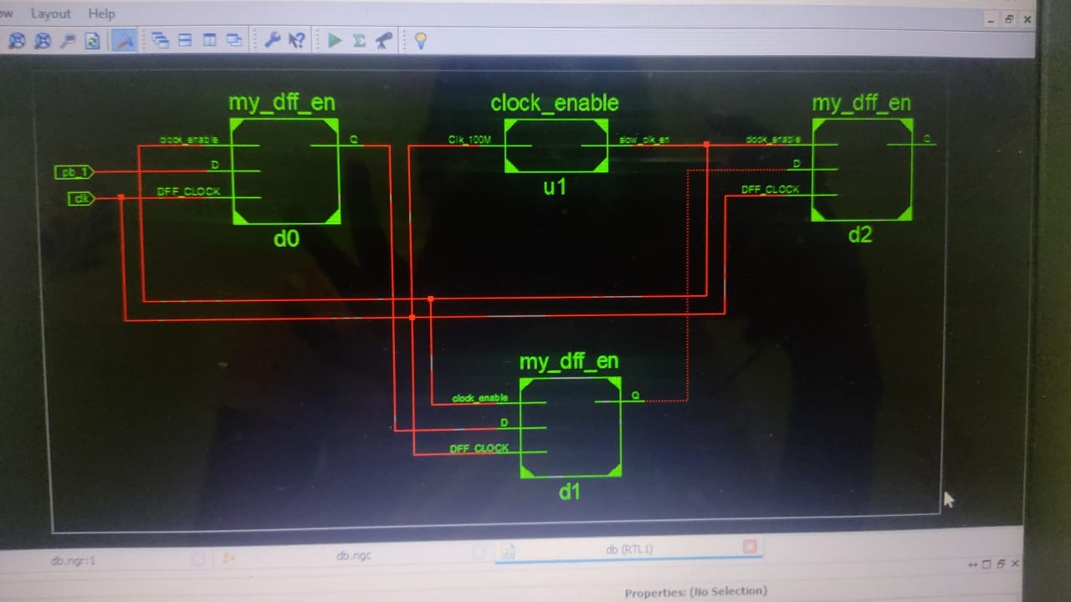
RTL schematic:

Slide 16
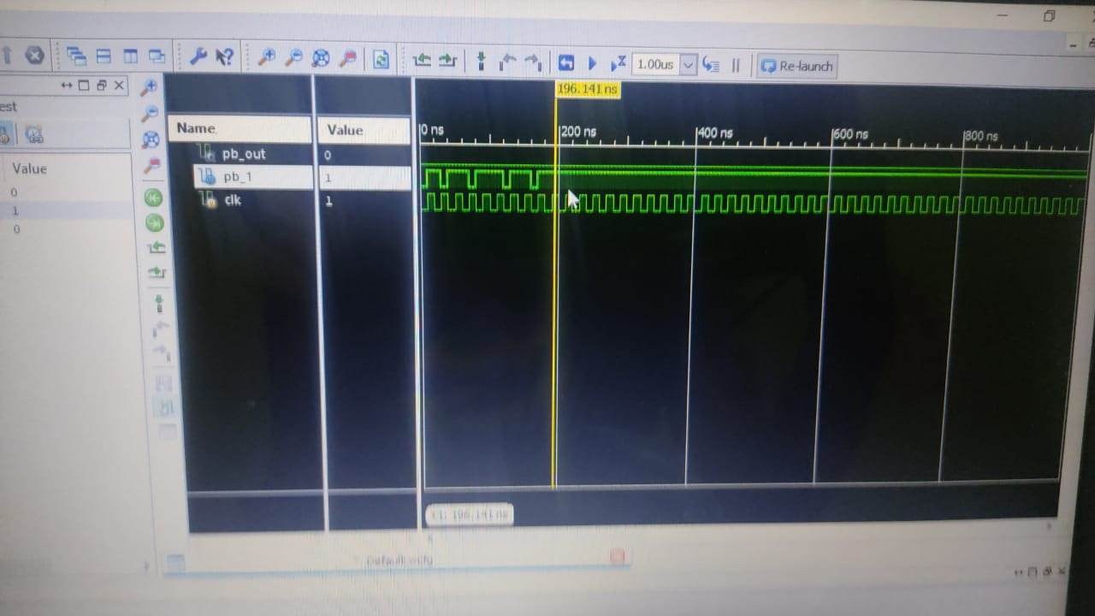
Simulation Output:

Slide 17
Application and conclusion:
Debouncing buttons on fpga is a method used to prevent bouncing. It is any kind of hardware device or software that ensures that only a single signal will be acted upon for a single opening or closing of a contact. It will ensure that it prevent ripple in the signal and allow to provide a clear transition of the signal.
The debouncing button on fpga applications include the following.
A debouncing circuit removes the resulting ripple signal, and provides a clean transition at its output.
These are used to prevent switch bounce.

